Slide 1

Night Vision Object Detection Using Machine Learning
BCA(DATA SCIENCE)
Student Name :
GUKAN.S
(221421601013)
SANJAY.G
(221421601048)
KAUSHIK.A.S
(221421601018)
Supervisor : Mrs.S.SABARIA
Designation :Assistant professor
DEPARTMENT OF COMPUTER APPLICATIONS

Slide 2
ABSTRACT
The project focuses on enhancing road safety by detecting objects such as animals, pedestrians, and vehicles in low-light or nighttime driving conditions using a standard night-vision camera.
Unlike conventional methods that rely on thermal cameras, the project uses a regular night-vision- enabled camera combined with machine learning techniques for real-time object detection.
The developed system detects and classifies objects (animals, people, vehicles) within the camera's range, alerting the driver when any object is within a 150-meter range.
It employs deep learning-based object detection models to process the camera feed and recognize the objects in real-time, offering enhanced driver awareness.
The approach provides an efficient and cost-effective alternative to expensive thermal imaging solutions, aiming to improve road safety without the high costs typically associated with thermal cameras.
DEPARTMENT OF COMPUTER APPLICATIONS

Slide 3
OBJECTIVE
Enhance Road Safety: To improve road safety in low-light and nighttime driving conditions by detecting and classifying objects such as animals, pedestrians, and vehicles.
Cost-effective Alternative: To create a more affordable and efficient alternative to traditional thermal cameras by using standard night-vision-enabled cameras combined with machine learning techniques.
Real-time Object Detection: Develop a system that can perform object detection in real-time using video feeds from a vehicle's front-facing camera.
Alert System for Drivers: Implement an alert system that notifies the driver when an object is within a 100-meter range, enhancing awareness of potential hazards.
Use of Deep Learning: Leverage deep learning-based object detection models for precise and accurate identification and classification of objects, making the system robust and reliable.
DEPARTMENT OF COMPUTER APPLICATIONS

Slide 4
PROBLEM IDENTIFIED
Traditional vehicle sensors, including standard cameras, often fail to detect objects such as animals or pedestrians effectively in low-light or nighttime conditions, leading to potential accidents.
Current solutions rely heavily on expensive thermal cameras for night vision, making them out of reach for many drivers and reducing accessibility for broader use.
Many existing detection systems suffer from slow response times, which can be critical in preventing accidents, especially when objects are suddenly encountered within close range.
Some existing systems do not provide real-time alerts or fail to alert drivers early enough to react, leaving gaps in critical driver awareness during low-visibility conditions.
Existing systems often fail to efficiently identify and classify objects in challenging environments like poorly lit roads, thereby compromising driver safety and confidence.
DEPARTMENT OF COMPUTER APPLICATIONS

Slide 5
BASE PAPER
Base paper Title: A novel framework for vehicle detection and tracking in night ware surveillance systems
Authors: NOUF ABDULLA HALMUJALLY1, ASIFA MEHMOOD QURESHI2, ABDUL WAHAB ALAZEB3,HAMEEDUR RAHMAN2,TOUSEEF SADIQ 4,(Graduate Student Member, IEEE),MOHAMMED ALONAZI5, ASAAD ALGARNI 6,ANDAHMAD JALAL.
Year: 2024
Objective: The primary objective is to develop a robust model that enhances the visibility and tracking accuracy of vehicles captured in aerial images during nighttime operations.
Limitation: The proposed method performs well for night time surveillance of road traffic.However, there are still some limitations of the model.
DEPARTMENT OF COMPUTER APPLICATIONS

Slide 6
LITERATURE SURVEY
S. No | Title | Author | Year | Pros & Cons
1 | A novel framework for vehicle detection and tracking in night ware surveillance systems | Almujally, N. A., Qureshi, A. M., Alazeb, A., Rahman, H., Sadiq, T., Alonazi, M., ... & Jalal, A. | 2024 | Pros: Innovative vehicle detection for night surveillance. Cons: Limited to night conditions and surveillance systems.
2 | Object detection for night surveillance using Ssan dataset based modified Yolo algorithm in wireless communication | Murugan, R. A., & Sathyabama, B. | 2023 | Pros: Modified YOLO for night surveillance improves detection. Cons: Performance dependent on dataset quality.
3 | Multiple pedestrian detection and tracking in night vision surveillance systems | Raza, A., Chelloug, S. A., Alatiyyah, M. H., Jalal, A., & Park, J. | 2023 | Pros: Effective for detecting and tracking pedestrians in night vision systems. Cons: Needs high computational power.
4 | A Robust Framework for Traffic Object Detection using Intelligent Techniques | Nandhini, T. J., & Thinakaran, K. | 2023 | Pros: Robust framework for traffic object detection. Cons: May not handle complex or dynamic traffic conditions well.
DEPARTMENT OF COMPUTER APPLICATIONS

Slide 7
LITERATURE SURVEY
S. No | Title | Author | Year | Pros & Cons
5 | Object detection in autonomous vehicles under adverse weather: A review of traditional and deep learning approaches | Tahir, N. U. A., Zhang, Z., Asim, M., Chen, J., & ELAffendi, M. | 2024 | Pros: Comprehensive review of traditional and deep learning methods for vehicle detection. Cons: Does not propose novel solutions.
6 | Improved metaheuristics with deep learning based object detector for intelligent control in autonomous vehicles | Alasmari, N., Alohali, M. A., Khalid, M., Almalki, N., Motwakel, A., Alsaid, M. I., ... & Alneil, A. A. | 2023 | Pros: Integrates metaheuristics with deep learning for intelligent vehicle control. Cons: Complex, might not be ideal for real-time applications.
7 | SMART on-board multi-sensor obstacle detection system for improvement of rail transport safety | Ristić-Durrant, D., Haseeb, M. A., Banić, M., Stamenković, D., Simonović, M., & Nikolić, D. | 2022 | Pros: Enhances rail transport safety with a multi-sensor system. Cons: May require expensive sensors and setup.
8 | Helmet detection using machine learning approach | Shenoy, M. A., Betrabet, P. R., & NS, K. R. | 2022 | Pros: Efficient helmet detection for safety applications. Cons: Limited scope, focusing only on helmet detection.
DEPARTMENT OF COMPUTER APPLICATIONS

Slide 8
LITERATURE SURVEY
S. No | Title | Author | Year | Pros & Cons
9 | Smart assistive system for visually impaired people obstruction avoidance through object detection and classification | Masud, U., Saeed, T., Malaikah, H. M., Islam, F. U., & Abbas, G. | 2022 | Pros: Assistive system for visually impaired using object detection. Cons: Requires constant sensor updates for optimal performance.
10 | Artificial intelligence based object detection and tracking for a small underwater robot | Lee, M. F. R., & Chen, Y. C. | 2023 | Pros: Uses AI for object detection and tracking in underwater robotics. Cons: Specific to small underwater robots, limiting its broader application.
DEPARTMENT OF COMPUTER APPLICATIONS

Slide 9
EXISTING SYSTEM
Most approaches rely on thermal cameras for detecting vehicles, animals, and pedestrians.
While effective, thermal imaging solutions are expensive and not widely available.
Many systems use conventional detection techniques, which can be computationally heavy.
Existing methods struggle in complex and dynamic settings.
Most systems work well only under specific conditions or with particular types of cameras.
Constraints in computational efficiency limit real-time processing capabilities.
DEPARTMENT OF COMPUTER APPLICATIONS

Slide 10
PROPOSED WORK
The proposed work aims to overcome limitations of current methods.
Uses standard night-vision-enabled cameras combined with deep learning-based object detection models.
More cost-effective, accessible, and capable of real-time detection.
Classifies objects such as vehicles, pedestrians, and animals in low-light conditions.
Provides an alert when any object is within a 150-meter range of the vehicle.
Enhances driver awareness and road safety using advanced machine learning techniques.
Offers a more efficient and affordable solution compared to thermal imaging systems.
DEPARTMENT OF COMPUTER APPLICATIONS

Slide 11
METHODOLOGY
Data Collection: Mention how you gathered the data. For night vision object detection, you might be using infrared camera footage, along with a dataset of labeled objects (e.g., cars, people, animals) in low-light conditions.
Preprocessing: Describe any preprocessing steps. This could involve image enhancement, noise reduction, or converting images to grayscale or a different format suitable for your model.
Model Selection: Explain the models you chose (e.g., YOLOv8 and R-CNN) and why they are suitable for your task. YOLOv8 might be good for real-time object detection, while R-CNN could provide better accuracy in detecting smaller or more complex objects.
Training: Explain how you trained your models (hyperparameters, batch size, number of epochs, etc.).
Evaluation: Mention how you evaluated your model performance, such as through accuracy, precision, recall, F1 score, or custom metrics related to your specific use case.
DEPARTMENT OF COMPUTER APPLICATIONS

Slide 12
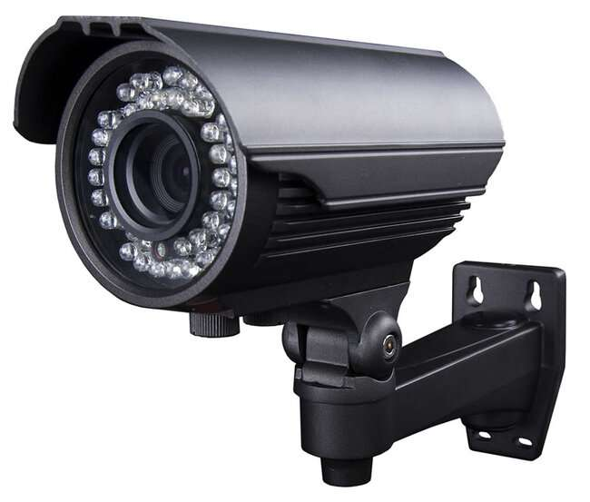






ARCHITECTURE DIAGRAM
Capture IR Video – Collects real-time frames.
Preprocess Image – Noise reduction, resize, normalize.
Run Object Detection – YOLOv8 or R-CNN detects objects.
Filter and Label – Highlights important detections like “car,” “person,” “animal.”
Store Detection Logs – Save detection results (object type, confidence, time).
Display/Alert – Shows results to the user in a UI or sends alerts.
DEPARTMENT OF COMPUTER APPLICATIONS

Slide 13
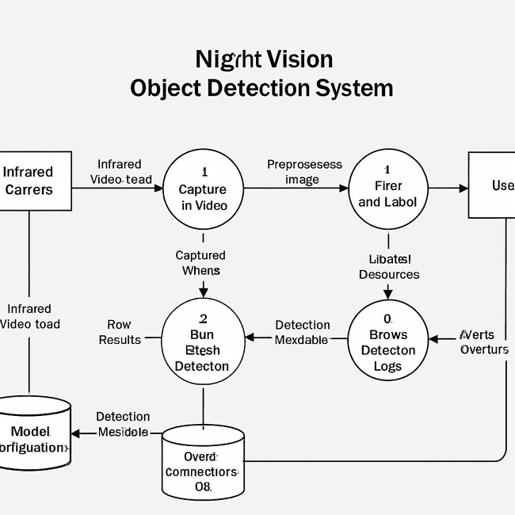
DFD
DEPARTMENT OF COMPUTER APPLICATIONS

Slide 14
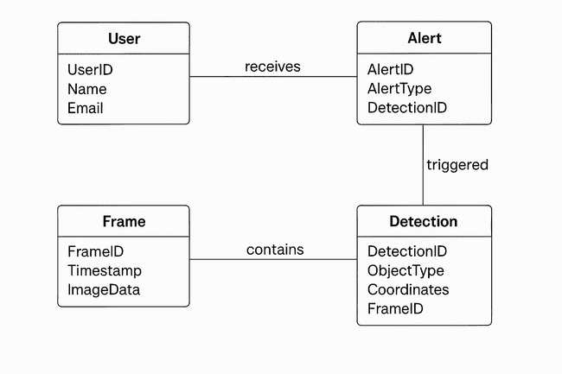
ER DIAGRAM
DEPARTMENT OF COMPUTER APPLICATIONS

Slide 15
MODULES
Data Collection and Preprocessing Process (EDA)
Object Detection Model
Distance Estimation
Alert System & Output Handling
DEPARTMENT OF COMPUTER APPLICATIONS

Slide 16
MODULE DEFINITION
Module 1: Data Collection and Preprocessing Process (EDA)
Data Collection: Source datasets from open platforms like Kaggle and Roboflow, including images of animals, pedestrians, and vehicles for night-time object detection.
Data Cleaning: Remove unnecessary rows and columns, handle missing data, and eliminate duplicates to refine the dataset for better quality.
Data Preprocessing: Normalize data, resize images, apply image augmentation (e.g., rotations, flips) to improve model performance.
Exploratory Data Analysis (EDA): Visualize dataset features, distributions, and class balance (e.g., object counts, bounding box sizes) to understand data characteristics.
Data Splitting: Split the data into training, validation, and testing sets to prepare for model training and evaluation.
DEPARTMENT OF COMPUTER APPLICATIONS

Slide 17
MODULE DEFINITION
Module 2: Object Detection Model
Model Selection: Choose a suitable deep learning model (e.g., YOLOv8, Faster R-CNN) for object detection tasks.
Training the Model: Load the preprocessed data and train the selected model, using techniques like data augmentation and hyperparameter tuning.
Model Evaluation: Use a test dataset to evaluate the model's performance using accuracy metrics like mean average precision (mAP).
Fine-tuning: Adjust model hyperparameters, such as learning rate, batch size, and epochs, to optimize detection accuracy.
Model Export: Save the trained model for future use in production (e.g., .h5 for Keras, .pth for PyTorch).
DEPARTMENT OF COMPUTER APPLICATIONS

Slide 18
MODULE DEFINITION
Module 3: Distance Estimation
Model Integration: Integrate the trained model into the backend using TensorFlow or PyTorch.
Inference Engine: Develop an API (e.g., FastAPI or Flask) to handle model inference requests.
Data Processing: Preprocess input images and format model outputs (bounding boxes, labels, etc.).
Real-time Processing: Implement real-time object detection with distance-based alerts (e.g., within a 150-meter range).
Optimization: Optimize model inference speed for real-time detection.
DEPARTMENT OF COMPUTER APPLICATIONS

Slide 19
MODULE DEFINITION
Module 4 :Alert System & Output Handling
User Interface: Build a Streamlit UI for users to upload images and interact with the model.
Prediction Display: Display detection results, including object labels and bounding boxes.
Live Alerts: Provide real-time alerts based on detected objects.
Integration with Backend: Send user-uploaded images to the backend for inference and receive predictions.
Deployment: Host the Streamlit app on cloud platforms (Heroku, AWS, etc.) for public access.
DEPARTMENT OF COMPUTER APPLICATIONS

Slide 20
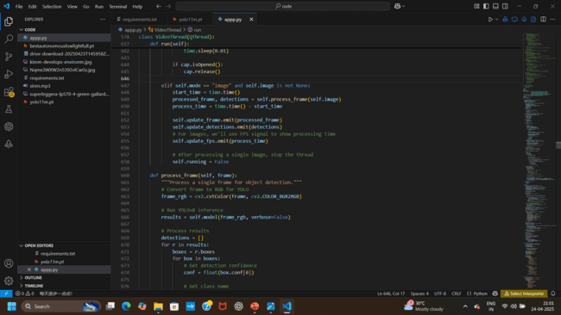
MODULE 1: DATA COLLECTION AND PREPROCESSING
DEPARTMENT OF COMPUTER APPLICATIONS

Slide 21
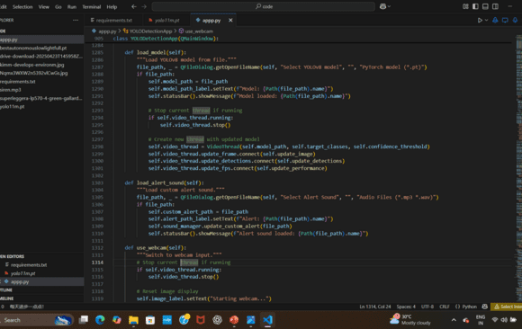
MODULE 2: OBJECT DETECTION
DEPARTMENT OF COMPUTER APPLICATIONS

Slide 22
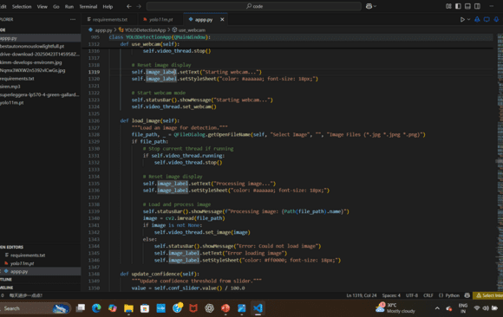
MODULE 3: DISTANCE ESTIMATION
DEPARTMENT OF COMPUTER APPLICATIONS

Slide 23
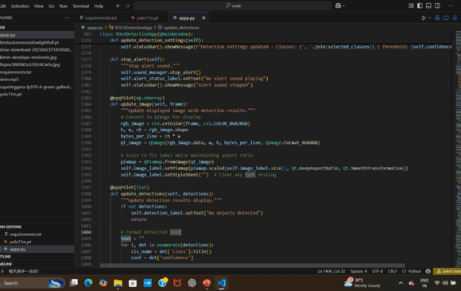
MODULE 4: ALERT AND OUTPUT HANDLING
DEPARTMENT OF COMPUTER APPLICATIONS

Slide 24
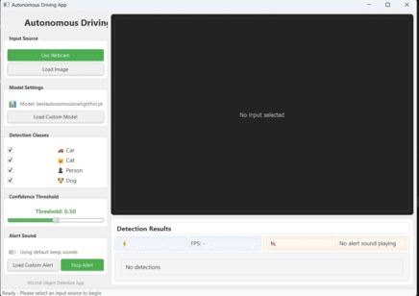
RESULT WITH ANALYSIS
STEP 1:
Run the code and it will open the webpage for user inter face
DEPARTMENT OF COMPUTER APPLICATIONS

Slide 25
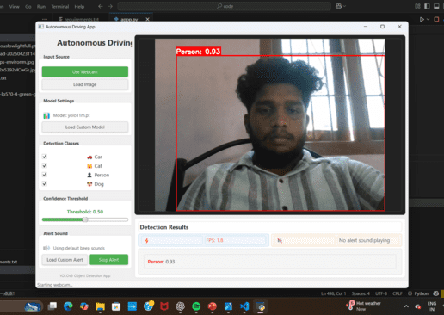
RESULT WITH ANALYSIS
STEP 2:
Click the use webpage to detect the object and in this set we detect the person
DEPARTMENT OF COMPUTER APPLICATIONS

Slide 26
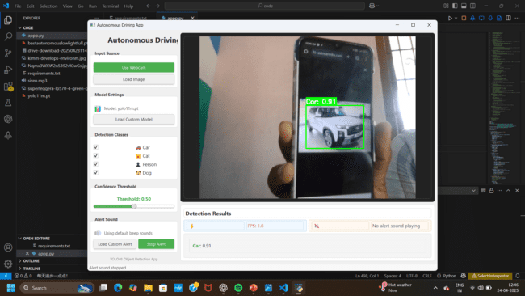
RESULT WITH ANALYSIS
STEP 3:
Click the use webpage to detect the object and in this
detect the car etc.,, it can detect the dogs,cat,cow uing this for
road safety.
DEPARTMENT OF COMPUTER APPLICATIONS

Slide 27
RESULT WITH ANALYSIS
STEP 4:
In this we can able to stop the alert sound because of any
detraction will get for the driver so we keep it if we can need on
otherwise off
DEPARTMENT OF COMPUTER APPLICATIONS

Slide 28
Detailed Algorithm for each module
YOLOv8 :
YOLOv8 is the latest version of the YOLO (You Only Look Once) object detection algorithm. It is designed for real-time object detection, classification, and segmentation with improved accuracy, speed, and efficiency.
Optimized for edge devices,object detection, classification, and segmentation.
Good accuracy.
R-CNN (Region-based Convolutional Neural Network):
It is an advanced deep learning model for object detection. It improves on previous versions (R-CNN, Fast R-CNN), making it faster and more efficient.
R-CNN is a high-accuracy object detection model.
Best for tasks where accuracy is more important than speed.
DEPARTMENT OF COMPUTER APPLICATIONS

Slide 29
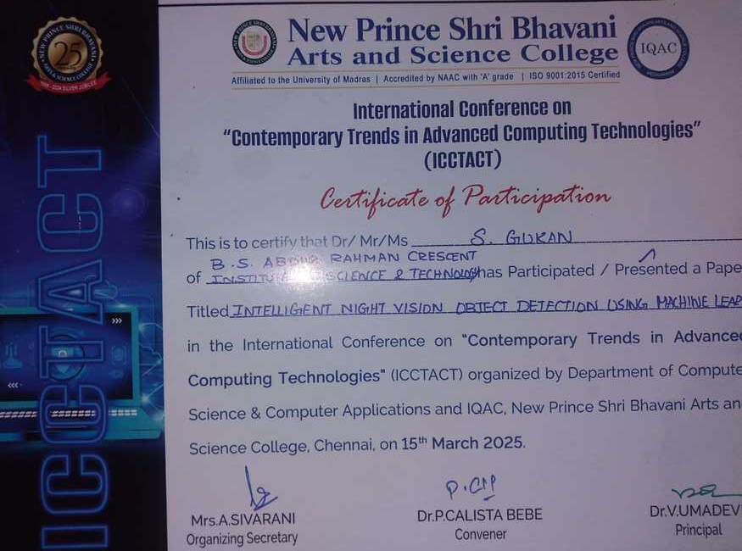
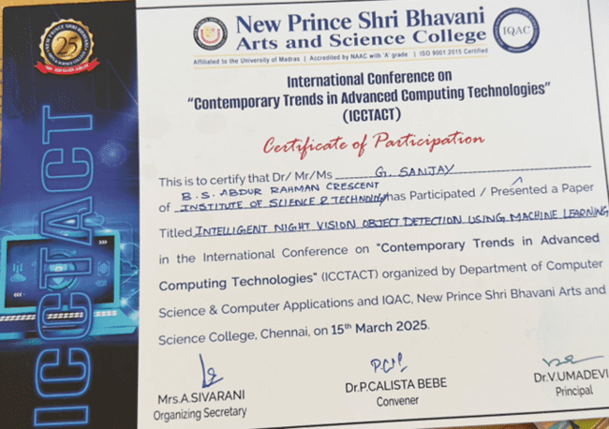
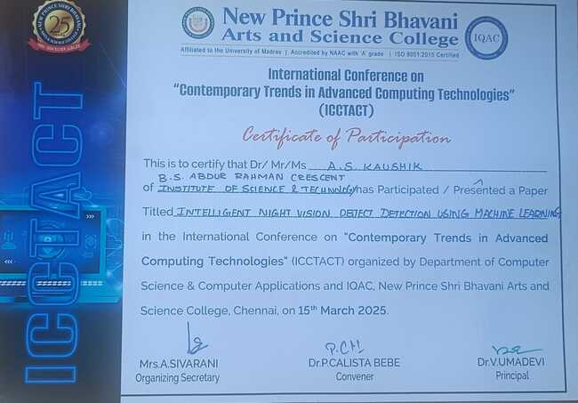
ACTION PLAN
Conference:
Attended International Conference on Contemporary Trends in Advanced Computing Technologies (ICCTACT 2024 )” ORGANIZED BY New Prince Shri Bhavani Arts and Science College on (15.03.2025)
GUKAN.S SANJAY.G KAUSHIK.A.S
DEPARTMENT OF COMPUTER APPLICATIONS

Slide 30



Technology Certification
NAME’S : Gukan.S , Sanjay.G , Kaushik.A.S
COURSE COMPLETED IN Image Processing And Computer Vision With Python & Opencv DATE : In Udemy App On (5.3.2025)
DEPARTMENT OF COMPUTER APPLICATIONS

Slide 31
CONCLUSION
The proposed system effectively enhances the detection of objects, such as pedestrians, animals, and vehicles, in low-light and nighttime conditions using a machine learning model, ensuring better road safety.
By utilizing standard night-vision-enabled cameras rather than expensive thermal imaging cameras, the project offers a cost-effective alternative that makes object detection accessible for a wider range of users.
The system is designed to process images in real-time, providing instant feedback to drivers, which is crucial for improving awareness and enabling faster reactions to potential hazards.
The integration of the backend model with a Streamlit web application ensures that the system is easy to use, allowing users to simply upload images and receive predictions with clear, visual outputs.
The project can be further enhanced by expanding its capabilities to handle video input, improving detection accuracy in more challenging environments, and integrating additional sensors for more robust real-time performance.
DEPARTMENT OF COMPUTER APPLICATIONS

Slide 32
FUTURE SCOPE
Improved Detection: You could explore improving the accuracy and robustness of your detection system by adding more training data or integrating more advanced techniques like Transfer Learning or Ensemble Models.
Real-time Processing: Discuss the potential for enhancing the real-time performance of the system, perhaps through model optimization (like using smaller models or applying quantization techniques).
Integration with Other Technologies: You might consider integrating the system with a larger application, such as a security system that automatically sends alerts when dangerous objects (like a person or car) are detected.
Scalability: Consider how your system could scale, such as supporting more cameras or operating in different environments (e.g., daytime, different weather conditions).
Enhanced User Interface: If your system has a user interface, you could develop it further to include more detailed visualizations, real-time monitoring, or historical logs.
DEPARTMENT OF COMPUTER APPLICATIONS

Slide 33
REFERENCES
Almujally, N. A., Qureshi, A. M., Alazeb, A., Rahman, H., Sadiq, T., Alonazi, M., ... & Jalal, A. (2024). A novel framework for vehicle detection and tracking in night ware surveillance systems. Ieee Access.
Murugan, R. A., & Sathyabama, B. (2023). Object detection for night surveillance using Ssan dataset based modified Yolo algorithm in wireless communication. Wireless Personal Communications, 128(3), 1813-1826.
Raza, A., Chelloug, S. A., Alatiyyah, M. H., Jalal, A., & Park, J. (2023, January). Multiple pedestrian detection and tracking in night vision surveillance systems. In CMC (Vol. 75, pp. 3275-3289).
Nandhini, T. J., & Thinakaran, K. (2023, March). A Robust Framework for Traffic Object Detection using Intelligent Techniques. In 2023 9th International Conference on Electrical Energy Systems (ICEES) (pp. 328-333). IEEE.
Tahir, N. U. A., Zhang, Z., Asim, M., Chen, J., & ELAffendi, M. (2024). Object detection in autonomous vehicles under adverse weather: A review of traditional and deep learning approaches. Algorithms, 17(3), 103.
Alasmari, N., Alohali, M. A., Khalid, M., Almalki, N., Motwakel, A., Alsaid, M. I., ... & Alneil, A. A. (2023). Improved metaheuristics with deep learning based object detector for intelligent control in autonomous vehicles. Computers and Electrical Engineering, 108, 108718.
Ristić-Durrant, D., Haseeb, M. A., Banić, M., Stamenković, D., Simonović, M., & Nikolić, D. (2022). SMART on-board multi-sensor obstacle detection system for improvement of rail transport safety. Proceedings of the Institution of Mechanical Engineers, Part F: Journal of Rail and Rapid Transit, 236(6), 623-636.
Shenoy, M. A., Betrabet, P. R., & NS, K. R. (2022, October). Helmet detection using machine learning approach. In 2022 3rd International Conference on Smart Electronics and Communication (ICOSEC) (pp. 1383-1388). IEEE.
Masud, U., Saeed, T., Malaikah, H. M., Islam, F. U., & Abbas, G. (2022). Smart assistive system for visually impaired people obstruction avoidance through object detection and classification. IEEE access, 10, 13428-13441.
Lee, M. F. R., & Chen, Y. C. (2023). Artificial intelligence based object detection and tracking for a small underwater robot. Processes, 11(2), 312.
DEPARTMENT OF COMPUTER APPLICATIONS

Slide 34

DEPARTMENT OF COMPUTER APPLICATIONS

